Slide 1


Slide 2

30 Days Python Master Class
Day1 : Python
Time: 6.00 PM IST
Free Registration

Slide 3
Python Master Class
Handbook

Slide 4
NANDHINI.S
Exp: 5 Yrs
Expert in
Python Developer on Machine Learning
Deep learning with computer vision
Matlab – Image Processing
Autonomous Car design using ROS with LIDAR
Language – Python , Java , HTML ,CSS.
Tools – ANACONDA NAVIGATOR, JUPYTER NOTEBOOK,
GOOGLE COLAB.
Graduation : BE – ECE | 2011

Slide 5
Pantech?
Educational Equipment Manufacturer
IoT, AI, Robotics,Autonomous Robot
Microprocessor/Microcontroller
DSP,VLSI, Embedded System
Power Electronics & Drives, Fuel Cell Trainer Kit
Renewable Energy Lab, Electric Vehicle Lab
Technical Training
DIY Project

Slide 6

What is Master Class ?
👍 This is the 30 Days Industrial Learning Activity.
👍 Its Online YouTube Live Class
👍 If you Invest 45 minutes daily, U will become Master in Data Science
👍 You will get FREE E-Certificate
Webinar Participation Certificate
“Learning is the beginning of wealth.
Searching & Learning is where the miracle process all begins.” …………….Jim Rohn

Slide 7
Our Vision
Help 10 Million Students to Learn the Technology in Easy Way

Slide 8

Associate Partner for this Master Class
https://apssdc.in/home/

Slide 9
What U will Learn from 30 Days Data Science & Analytics Master Class

Slide 10
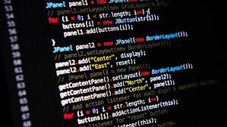
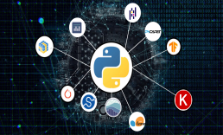

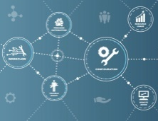

Python Learning Plan
01
02
03
04
05
Library
Python
Analytics
Analytics
Industry Project
Introduction To Python and Python Data Structures
Pandas
Numpy
MatplotLib
Cborn, SKLearn Lib
Collab
Distribution
Visualization
Aggregation
Statistics
Distribution Function
Project Building

Slide 11
Day wise Learning Plan
Day -1 : Introduction to Python
Day -2: Python – Tools|Syntaxes & Data Structures
Day -3: Python – Dictionaries,Date and Time
Day -4: Python – MySql
Day -5: Pandas library – Introduction
Day -6: Pandas library – Data Structures
Day -7: Numpy library – Introduction
Day -8: Numpy library – Array Manipulations, Mathematical Functions
Day -9: Matplotlib , Histogram Using Matplotlib | I/O With Numpy
Day -10: Matplotlib Library - Introduction , Pyplot API | Types Of Plots
Day -11: Seaborn Library
Day -12: SKLearn Library
Day -13: Python – Date and Time , Data Wrangling.
Day -14: Python – Data Cleansing
Day -15: Python – Word Tokenization , Stemming and Lammetization.

Slide 12
Day wise Learning Plan
Day -16: Python – Data Visualization
Day -17: Python – Statistical Analysis
Day -18: Python – Types Of Distribution
Day -19: Python – Correlation ,Chi-Square Test , Linear Regression
Day -20: Keras library – Introduction.
Day -21: Stock Price Prediction With Machine Learning LSTM RNN
Day -22: People’s behaviour in chat message using NLP NLP
Day -23: Gaming In Python
Day -24: Chatbot creation in Python NLP
Day -25: Electricity Price Prediction Using ML Random Forest Regressor
Day -26: Diamond Price Prediction Using Python Linear Regression
Day -27: Book Recommendation System KNN
Day -28: Image Classification Using CNN CNN
Day -29: Titanic Survival Analysis Using ML Logistic Regression
Day -30: Blockchain in Python

Slide 13
List of Projects for Demo in YouTube Live
Stock Price Prediction With Machine Learning
People’s behaviour in chat message using NLP
Gaming In Python
Chatbot creation in Python
Electricity Price Prediction Using ML
Diamond Price Prediction Using Python
Book Recommendation System
Image Classification Using CNN
Titanic Survival Analysis Using ML
Blockchain in Python
All Projects in Jupyter Notebook

Slide 14
What you will get from this Free 30 Days Master Class?
You can attend YouTube Live Class
Free E-Certificate ( WEBINAR PARTICIPATION CERTIFICATE)

Slide 15
How to mark your Attendance in YouTube Live Class?
Ans : During the Live Class, organizer will post Google Form link in Live Chat. The Participants should submit the from on daily basis. Minimum 25 Days Attendance is Required to get Free Master Class Participation Certificate.
Note : The Link will be available during the Live. From the LIVE Class date, the live video will get removed from the YouTube in 3 days.

Slide 16
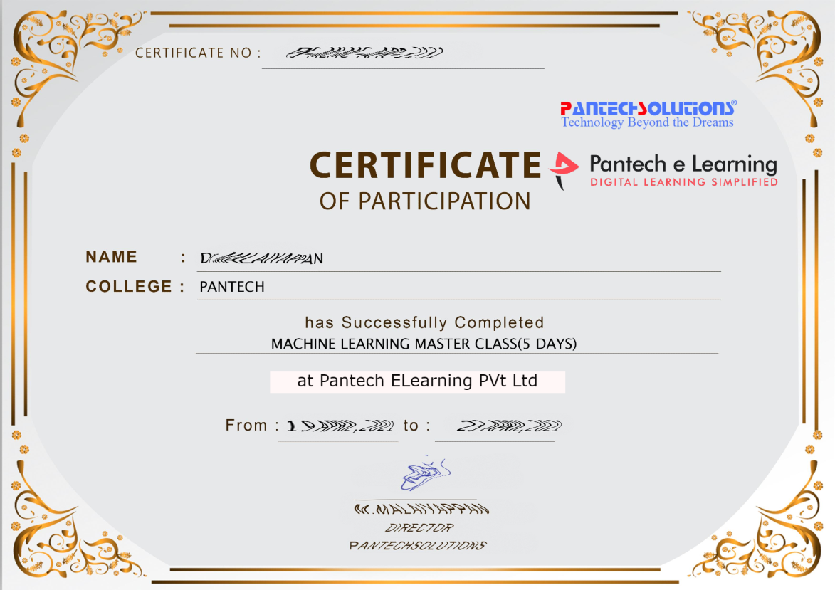

Sample Webinar Participation Certificate?

Slide 17
https://www.pantechelearning.com/data-science-master-class/
On Demand
You can get chance to apply 1 Month Internship on Data Science & Analytics Master Class

Slide 18
What is Internship????
Learn
Practice
Verify
Get Certified
Grow

Slide 19
Free Master Class DSA | 1 Month Internship on DSA
Master Class Participation Certificate | Internship Completion Certificate
Minimum 25 Class should attend YouTube Live | Recorded Class Link will be provided. – LMS Portal Access
YouTube Live Mandatory | Your Choice. You can attend Live or else You can watch Recorded Class in LMS Portal
All Projects Demo class in YouTube Live | Step by Step Video Explanation Content in LMS Portal
Access : 3 Days | VIP WhatsApp Group Support
 | You Can Download All PPTs
 | 4 Nos of Hackathon Class in Zoom Live. The Recording also will be provided
 | You Can Download All Project Files
 | Mentor will guide you to finish 10 Projects
 | Access : 60 Days

Slide 20
Pantech will make you to Create 10 Projects in Data Science & Analytics in 30 Days
Objective of this 30 Days Master Class

Slide 21
1 Month Internship in Data Science
INTERNSHIP E-Certificate(30Days Internship on Data Science Engineering)
Highly organized Video content
Download All Files
Download PPTs
Assignments
Flexible Time.
Access Period: 60Days from the date of payment

Slide 22
What You Will Get???
Complete Project Files
30 Days Learning Activity
Data Science Core Concepts
10 + Projects
Project PPT
Spatial Data Science For Covid-19 Disease Prediction
Parkinson’s Disease Prediction-XGBoost Classifier
House Price Prediction-Random Forest Regression
Customer Segmentation Using ML-K-Means Clustering
Home Loan Prediction-Decision Tree Classifier
Spam Classification-NLP
Hand Written Digit Recognition Using Python-CNN
Churn Prediction-Deep Learning
Crop Yield Prediction
Ground water level prediction
Video Class Access for 2 Months
Get chance to Enroll 1-Month Internship on demand

Slide 23
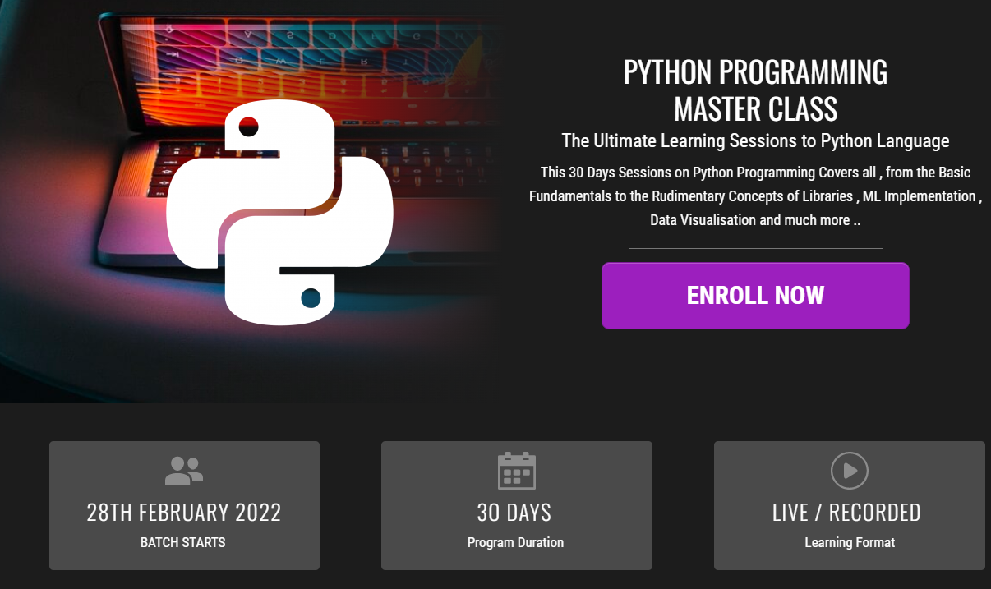
How to join in 1 month Internship
https://www.pantechelearning.com/pymc-internship/
Coupon Code: PYMC

Slide 24
Women’s Christian College
Department Of Computer Applications.
Python Programming For Data Science.
Convenor:
Ms.Sylvia Mary D
(HOD)
(Department Of Computer Applications)

Slide 25
Webinar On Python Programming For Data Science

Slide 26
Overview of Pantech eLearning
Profile
Training
01
04
02
R & D
03
Services
Established on 2004 7 Wings 100+ Team Size
2000 + Workshops 300+ FDP’s 12.5 Lacs + Students
Industrial Design Services Lab Equipment Manufacturer Working on Funded Projects
Workshops, FDP’s Internships, Value Added Courses Online Training Project Guidance

Slide 27
Follow us on:
Instagram--https://instagram.com/pantechelearning?igshid=1fohp030onteu
Telegram--https://t.me/pantechelearning
YouTube--https://youtube.com/c/PantecheLearning.
Podcasts--https://www.instagram.com/tv/COPQIigJZFi/?igshid=4gjhz4dlls1p

Slide 28
NUMPY-Numerical python
It stands for numerical python .
It is a library .It consists of multi-dimensional array objects and a group of routines for processing those arrays.
Numpy can be used to perform mathematical and logical operations on arrays.
In this chapter , we are going to discuss about various array functions and types of indexing.

Slide 29
Pre-requisites
Computer – Programming terminologies.
A basic understanding of python.

Slide 30
OPERATIONS THAT CAN BE PERFORMED USING ARRAY:
Using Numpy , the following operations can be performed.
Mathematical and logical operations on arrays.
Fourier Transform are used for performing shape manipulation.
Linear-Algebric operations.
It has in-built functions for linear algebra and random number generation.

Slide 31
Combination of other packages with numpy:
It can be used with other packages like Scipy(ScientificPython) and Mat-plotlib(Plotting library).
Numpy is open – source and can be used as a replacement for matlab.

Slide 32
NUMPY – ENVIRONMENT:
Standard python distribution does not come together with numpy module.
Numpy can be installed .
Anaconda is a free python distribution.

Slide 33
NUMPY:
To test if numpy works properly or not, import it from python prompt.
Import numpy
Numpy is imported using the following syntax
Import numpy as np

Slide 34
Numpy-NDARRAY OBJECT
Important array object defined in Numpy is an n-dimensional array type called ndarray.
It describes the group of items of the same type.
Each item in the collection can be accessed using the zero-based index.
Every item in the ndarray occupies the same amount of memory.
Each element in an ndarray is an object of data-type object(called dtype).

Slide 35
numpy
An instance of ndarray class can be constructed by different array creation routines.
Numpy.array
Ex,numpy.array(object,dtype=None,copy=True,order=None,subok=False,ndmin=0)
The constructor takes the following parameters.

Slide 36
PARAMETER - DESCRIPTION
Object – Any object exposing the array interface method returns an array object.
Dtype – Desired datatype of the object.
Copy – By default,the object is copied.
Order - C (row major) or F (column major) or A (any) (default)
Subok – Returned array is forced to be a base class array.
Ndmin – Specifies min dimensions of resultant array.

Slide 37
EXAMPLE1:
import numpy as np
a = np.array([1,2,3])
print a

Slide 38
Output:
[1,2,3]

Slide 39
Task:
Write a program which takes a list of floating point values and prints at the output.

Slide 40
Example2:
# more than one dimensions
import numpy as np
a = np.array([[1, 2], [3, 4]])
print a

Slide 41
Output:
[[1, 2]
[3, 4]]

Slide 42
Task:
Fill in the missing code:
________numpy __ np
B = np______([_______);
Print(__);

Slide 43
Example3:
# minimum dimensions
import numpy as np
a = np.array([1, 2, 3,4,5],
ndmin = 2)
print a

Slide 44
Output:
[[1, 2, 3, 4, 5]]

Slide 45
Example 4:
# dtype parameter
import numpy as np
a = np.array([1, 2, 3], dtype = complex)
print a

Slide 46
OUTPUT:
[ 1.+0.j, 2.+0.j, 3.+0.j]

Slide 47
TASK:
Write a program to specify the datatype and get the result at the output.

Slide 48
doubts:

Slide 49
Numpy - datatypes
It supports a much greater variety of numerical types than python does.
A dtype object is constructed using the following syntax:
Numpy.dtype(object,align,copy)
Object – to be converted to datatype object.
Align – If true , adds padding to the field.
Copy – If true , makes a new copy of the dtype object.

Slide 50
Example 1:
# using array-scalar type
import numpy as np
dt = np.dtype(np.int32)
print dt

Slide 51
Output:
int32

Slide 52
Numpy – array attributes
Ndarray.shape: It returns a tuple containing array dimensions.
It is used to resize the array.
Example 1:
import numpy as np
a = np.array([[1,2,3],[4,5,6]])
print a.shape
Output:
(2,3)

Slide 53
EXAMPLE 2:
# this resizes the ndarray
import numpy as np
a = np.array([[1,2,3],[4,5,6]])
a.shape = (3,2)
print a

Slide 54
Output:
[[1, 2] [3, 4] [5, 6]]

Slide 55
TASK:
Write a program to illustrate the use of reshaping or resizing the array using numpy.

Slide 56
Example 3:
It provides a reshape function to reshape a array.
import numpy as np a = np.array([[1,2,3],[4,5,6]])
b = a.reshape(3,2)
print b
Output:
[[1, 2]
[3, 4]
[5, 6]]

Slide 57
TASK:
Find the error in the following code:
Imprt numpy a n
X = np.array([45,6,7],[67,8,9)
H = xreshap(9)
Print(h)

Slide 58
Ndarray.dim
This array attribute returns the number of array dimensions.
Example 1:
# an array of evenly spaced numbers
import numpy as np
a = np.arange(24)
print a

Slide 59
Output:
[0 1 2 3 4 5 6 7 8 9 10 11 12 13 14 15 16 17 18 19 20 21 22 23]

Slide 60
TASK:
Write a program to illustrate the use of arange function

Slide 61
Example 2:
# this is one dimensional array
import numpy as np
a = np.arange(24)
a.ndim # now reshape it
b = a.reshape(2,4,3)
print b # b is having three dimensions

Slide 62
Output:
[[[ 0, 1, 2]
[ 3, 4, 5]
[ 6, 7, 8]
[ 9, 10, 11]]
[[12, 13, 14]
[15, 16, 17]
[18, 19, 20]
[21, 22, 23]]]

Slide 63
Numpy.itemsize:
This attribute returns the length of each element of array in bytes.
Example 1:
# dtype of array is int8 (1 byte)
import numpy as np
x = np.array([1,2,3,4,5], dtype = np.int8) print (x.itemsize)

Slide 64
output:
1

Slide 65
NUMPY.FLAGS
It has the following attributes.
C_CONTIGUOUS (C)
The data is in a single, C-style contiguous segment
F_CONTIGUOUS (F)
The data is in a single, Fortran-style contiguous segment
OWNDATA (O)
The array owns the memory it uses or borrows it from another object
WRITEABLE (W)
The data area can be written to. Setting this to False locks the data, making it read-only

Slide 66
Numpy.flags:
ALIGNED (A)
The data and all elements are aligned appropriately for the hardware
UPDATEIFCOPY (U)
This array is a copy of some other array. When this array is deallocated, the base array will be updated with the contents of this array

Slide 67
Example:
import numpy as np
x = np.array([1,2,3,4,5])
print x.flags

Slide 68
Output:
C_CONTIGUOUS : True
F_CONTIGUOUS : True
OWNDATA : True
WRITEABLE : True
ALIGNED : True
UPDATEIFCOPY : False

Slide 69
NUMPY – ARRAY CREATION ROUTINES
Numpy.zeroes:
It returns a new array of specified size,filled with zeroes.
numpy.zeros(shape, dtype = float, order = 'C') shape – Shape of an empty array in int.
Dtype – desired output datatype.
Order – C for C-style row major array.

Slide 70
Numpy – array from existing data:
Numpy.asarray: It is used for converting python sequence into an n-dimensional array.
Declaration:
Numpy.asarray(a,dtype=None,order=None)
It takes the following arguments:
A – Input in any form such as list or list of tuples.
Dtype – By default , the datatype of the input data is applied to the resultant array.
Order – C-Row Major

Slide 71
Example 1:
# convert list to ndarray
import numpy as np
x = [1,2,3]
a = np.asarray(x)
print a

Slide 72
Output:
[1 2 3]

Slide 73
TASK:
Find the error in the following code:
Impo Numpi a np
S (1,2,2);
H=np.();
Pr(h);

Slide 74
Numpy – indexing and slicing
Contents of ndarray object can be accessed by indexing or slicing.
Example 1:
import numpy as np
a = np.arange(10)
s = slice(2,7,2)
print a[s]

Slide 75
Output:
[2 4 6]

Slide 76
TASK:
Write a program to illustrate the slicing concept using numpy

Slide 77
Example:
import numpy as np
a = np.arange(10)
b = a[2:7:2]
print b

Slide 78
Output:
[2 4 6]

Slide 79
Example 3:
# array to begin with
import numpy as np
a = np.array([[1,2,3],[3,4,5],[4,5,6]])
print 'Our array is:'
print a
print '\n' # this returns array of items in the second column print 'The items in the second column are:'
print a[...,1]
print '\n'
# Now we will slice all items from the second row
print 'The items in the second row are:'
print a[1,...]
print '\n‘
# Now we will slice all items from column 1 onwards
print 'The items column 1 onwards are:‘
print a[...,1:]

Slide 80
DOUBTS:

Slide 81
OUTPUT:
Our array is: [[1 2 3] [3 4 5] [4 5 6]]
The items in the second column are: [2 4 5]
The items in the second row are: [3 4 5]
The items column 1 onwards are: [[2 3] [4 5] [5 6]]

Slide 82
NUMPY – ITERATING OVER AN ARRAY:
Numpy package:It contains an iterator object nditer
It is a multidimensional array object which is used to iterate over an array.
Each element of an array is accessed using the python standard iterator interface.

Slide 83
EXAMPLE 1:
import numpy as np
a = np.arange(0,60,5)
a = a.reshape(3,4)
print 'Original array is:'
print a
print '\n'
print 'Modified array is:'
for x in np.nditer(a):
print x,

Slide 84
TASK:
Write a program to illustrate the use of nditer object.

Slide 85
Follow us on:
Instagram--https://instagram.com/pantechelearning?igshid=1fohp030onteu
Telegram--https://t.me/pantechelearning
YouTube--https://youtube.com/c/PantecheLearning.
Podcasts--https://www.instagram.com/tv/COPQIigJZFi/?igshid=4gjhz4dlls1p

Slide 86
THANKS
Further Information:
Senthil Kumar – 98409 74406
Srinivasan – 7010888841
Kumarasamy - 8925533489
www.pantechelearning.com | training@pantechmail.com

